Slide 1
N

Slide 2
E

Slide 3
-

Slide 4
Y

Slide 5
O

Slide 6
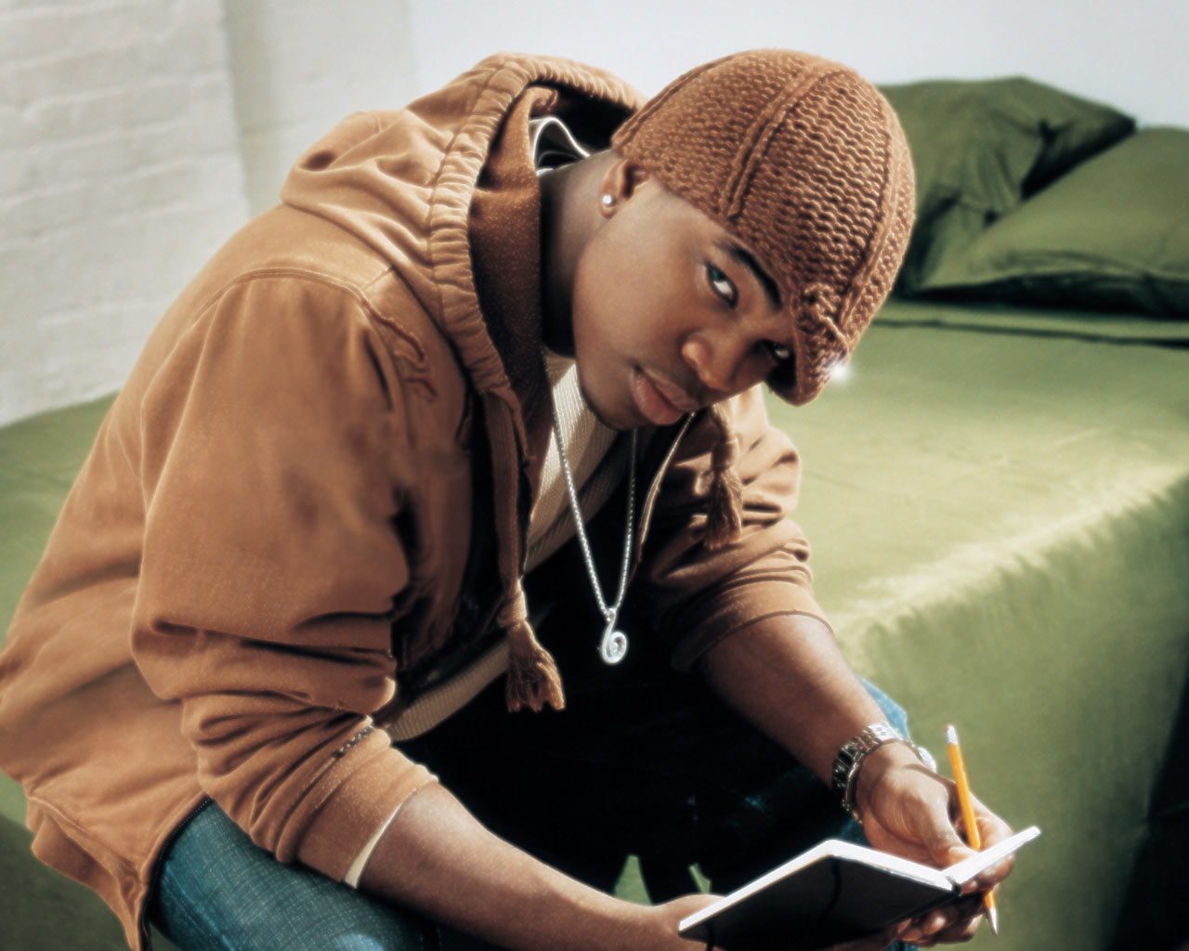

Slide 7
He’s a
Composer

Slide 8
Singer

Slide 9
choreographer

Slide 10
actor

Slide 11
his inspiration

Slide 12
Motivation

Slide 13
determination

Slide 14
Never give up

Slide 15
Ne-yo

Slide 16
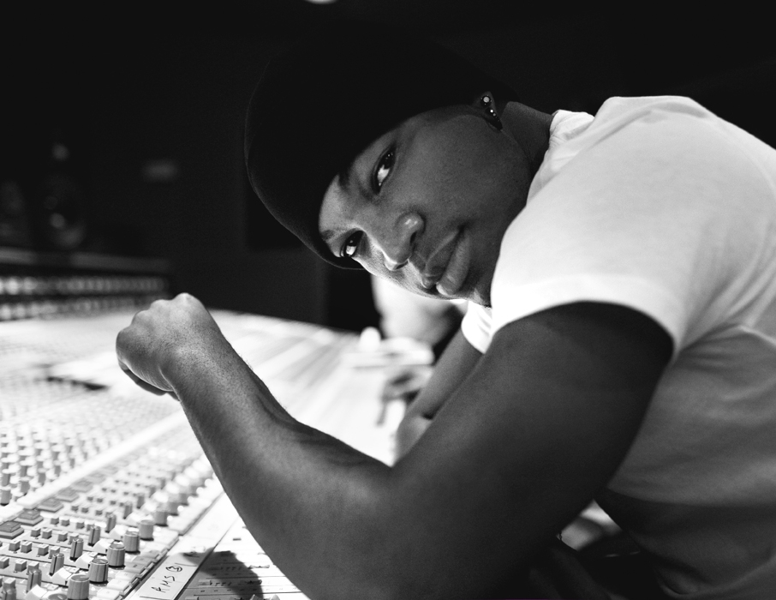

Slide 17
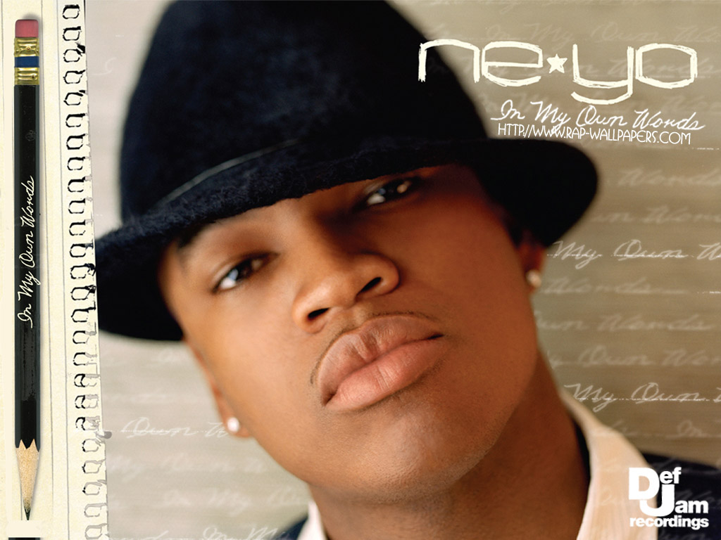

Slide 18


Slide 19
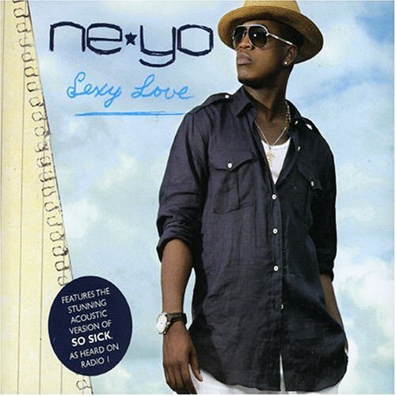

Slide 20


Slide 21


Slide 22
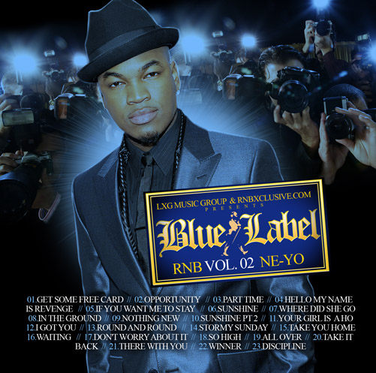

Slide 23


Slide 24


Slide 25
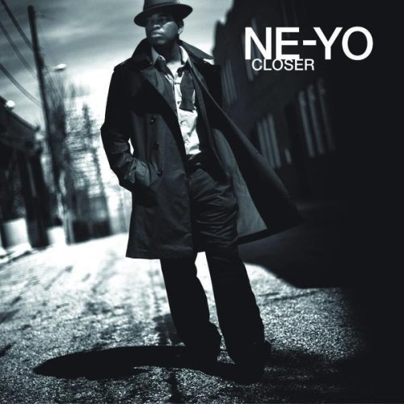

Slide 26


Slide 27


Slide 28


Slide 29
Present

Slide 30
In the beginning………
Notes:
This is the start of my biography section.

Slide 31
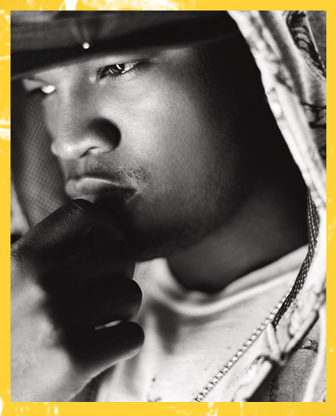
Ne-yo
Aka Shaffer Chimer Smith
Born October 18 1982 in Camden, Arkansas
He moved with his mother to Las Vegas, Nevada after his parents separation.
His high school group was called Envy
They didn’t make it to far, the group broke up in 2000 and ne-yo went solo.
Notes:
Shaffer Chimer Smith is known in the music world as Ne-yo, he was born on October 18 1982 in Camden, Arkansas. Ne-yo’s father is African American and his mother is African American and Chinese. His mother relocated them to Las Vegas, Nevada after her separation with his father at a young age in hope of a better life.
He later attended Las Vegas Academy where he got together with an R&B group called Envy and was going with the name GoGo. The group appeared at the Apollo on amateur night and MTV “The Cut,” but didn’t make it far and broke up in 2000 but Shaffer was still working hard writing music for other artist’s before he went solo.

Slide 32
His first deal

Slide 33
Columbia Records
Signed on with Columbia record but was quickly disappointing
Marques Houston took Ne-Yo’s song “That Girl” for his debut song. Which lead him into the sixty third spot on the Billboard.
Ne-Yo was given credit as a talented song writer, but not a singer.
Notes:
Ne-yo signed on with Columbia records and was getting ready to release his debut album with the single “That Girl” but was dropped before that could happen. Marques Houston was given that song instead for his debut in 2003, the single made it to the sixty third spot on the Billboard Top 100. That single helped Ne-yo be recognized as a talented songwriter. For the next couple of years he continued writing songs for singer Christina Milian’s “ It’s about time” and Teedra Moses’s 2004 Complex Simplicity album, Along with other American singers like Mary J Blige, Faith Evans, B2k and others.

Slide 34
The opportunity

Slide 35
Number one hit
Ne-Yo wrote a song “Let me love you” for American singer Mario. It got the number one spot on the Billboard for nine weeks straight.
It caught the attention of Tina Davis, former Def Jam Record representative.
He was given a unofficial meeting with leading Def Jam Record Executives.
Jay Z, CEO of Def Jam signed him on with them.
Notes:
But he didn’t received the recognition that he deserved until he wrote the song “Let me love you,” in 2004 that hit number one on the Billboard Hot 100 for American singer Mario. The single stayed at number one for nine weeks straight. That caught the attention of former A&R representative of Def Jam Recording, Tina Davis, who introduces Shaffer to head label L.A Reid. At that time Ne-Yo was not looking for a new contract, but after his performance that he put on for them. CEO of Def Jam, Hip Hop artist “Jay Z” was ready to welcome Ne-Yo on board.

Slide 36
2006 a new artist is heard….

Slide 37
His Debut
“So Sick,” was heard by millions and gave him the number one spot on the billboards
Over a
Million unit was sold.
The album went…
Platinum
Notes:
Then on from there, in 2006 he debut a song, “So Sick” through Def Jam. It hit number one with that single making him well known in the music industry. His album “In My Own Words” made it to the number one spot on the Billboard Top 200 and sold over 300,000 copies the first week.
That album also had other popular songs like, “When You’re Mad,” “Sexy Love” and is now a platinum album and has sold over a million units, that’s always a nice start for anyone.

Slide 38
Second and Third
His second album got him the
Grammys
His Third album got nominated
Album of the Year
Notes:
He then moved on to his second album, “Because of You” which was released in May 2007 and was in the number one spot the first week it was released, the album received “Best Contemporary R&B Album” at the 2008 Grammy Awards. This album has also went and sold over 1.6 million copies, also in 2007 Ne-Yo and the Goo Goo Dolls performed for the Senator now the President of the United States, Barack Obama.
His third album was not released to US first but to Japan in September of 2008 titled, “Year of the Gentleman,” the album sold 250,000 copies in the first week it was released in America and was on the Billboard at number two. This album went on to earn him seven Grammy nominations including, “Album of The Year” and made platinum. It also went on to sell 600,000 copies and hit double platinum in the UK.

Slide 39
2009
Released a song for
Disney “Princess and the Frog”
Collaborated with Mariah Carey
Before moving on to his fourth album
Notes:
Following from that in September 2009, Ne-Yo released a greatest hits album. Naming it “Ne-Yo - the collections” and sold over 55,000 copies. It was at the number four spot on Japan’s Oricon charts.
In October of 2009 he made a song for the Disney Movie “The Princess and the frog” called “Never knew I needed.” Then moving on to February 2010 where he collaborated with Mariah Carey to make the song, “Angel Cry” the song made it as a single and a music video. But the full album was cancelled and never released, which would have had the title of “Angels Advocate” by Mariah Carey. The single did get released in United States, Australia, United Kingdom, Japan and New Zealand.

Slide 40

Libra Scale

Slide 41
Fourth Album
Libra Scale
Short Movie
His fourth album was a creation of his interest in Sci-Fi, Japanese Animation and Super Heroes.
Libra Scale was also Ne-Yo’s experiment with his music video’s to create a short movie with a few songs in that album.
The songs, "Beautiful Monsters, Champagne Life and One in a Million,” where the songs for the short movie.
Notes:
By June of 2010 his fourth album was on its way to being released called, “Libra Scale,” this album had also a story line to all songs that were written in the album. Ne-Yo along with Stargate Productions wanted to create a film through the videos. Ne-Yo explained that the album is telling a story of three garbage men, who was given super human powers and that there duty is to fight for justice in the world.
Following that a few of his music videos for this album were tied together, including the first single “Beautiful Monsters”. Then the second was “Champagne Life” and to tie it all off was, “One in a Million” all released within a few months apart. Then the complete album was released on November 2010.
The album debuted at number nine in the Billboard Top 100 and sold 112,000 copies not as high as some of his previous album. But it was enough to make it his fourth album in the top 100. He said that the reason for this album came about, from his interest for Sci-Fi films, Comic books and Japanese animation. His got a lot of his inspiration from Micheal Jackson’s movie, “Moonwalk” and music videos like thriller and bad. Finally for his latest album “Red” that has not been release yet features music like “Burnin”, “Let me love you (so I can love you)” is In

Slide 42
Soon to be released
2012 in fall will be the release of his latest album R.E.D
This album includes his new song’s “Let me love you(until you learn to love yourself)”,”lazy love” and “burnin up.”

Slide 43
Other acheivements
Actor
Carrington House, in Atlanta, Georgia
Battle – Los Angeles
Save the Last Dance 2
Stomp the Yard
CSI – New York
Red Tails
Signed singers
Paula Cambell
Sixx John
Shanell and more…
Notes:
But Ne-Yo does not only sing or compose music, he also plays on the widescreen in movies for example “Battle – Los Angeles” , “Save the Last Dance 2” as Mixx ,”Stomp the Yard” as Rich Brown, “CSI- New York”, “Battle- Los Angeles” as Cpl Kevin Harris and the latest “Red Tails.”
Ne-Yo also opened his own recording studio called Carrington House in Atlanta, Georgia in 2007. Ne-Yo has invited new singers like Paula Cambell, Sixx John, Shanell and others to create their careers in his studio, in hopes to establish a full fledged label. So with all the things that Ne-Yo does as a singer, composer, choreographer, studio manager, and actor. He still manages to write songs for other talented artists out there including Beyonce Knowles, Rihanna, Celine Dion, the late Whitney Houston, Carrie Underwood

Slide 44
Composition history
So Sick
Closer
Song Length: 3.27
Label: Def Jam Records
First Hit Single
Made several remixes
Made Platinum and was used in a game.
Length: 3:54
Label: Def Jam Records
Number one on Billboards
Grammys award
Sang on WB tv series
Notes:
Titled Song: So Sick
Length: 3:27
Label: Def Jam Records
“So Sick,” is Ne-Yo’s first hit single that he wrote back in 2005 with the help of the Norwegian production team Stargate. Eriksen and Tor Erik Hermansen crossed paths with Ne-Yo in the hallway of Sony Music studio after Stargate had settled there in 2005. They helped him in composing the music, while neyo wrote the lyrics. In his first album, “In my own words” they helped him with six of the songs.
He said he wrote this song because of his ex-girlfriend. The song explains about the mistake that he made while he was with her and now that he lost her every time he hears a specific song on the radio it reminds him of her. It is a tragic song, but also a song that brought his name out into the world and gave him the number one spot on the Billboard Top 100.
The song went on to be remixed with rapper artist LL Cool J, Asian rapper Jin, Def Jam Ceo Jay Z and also with Fall Out Boys lead singer Patrick Stump. It was also later played by Saxophonist Kim Waters on track number one of his album “You Are My Lady” and it even got an unofficial part in the game “Saint Rows 2.” Lastly in 2011 it was sung by Australian singer Che’Nelle in her album “Luv Songs.” I’d say that is an amazing start for a debut single and it turned his first album platinum.
Song Title: Closer
Length: 3:54
Label: Def Jam Records
In 2008 was another big year for Ne-Yo as he finish recording his next big hit single “Closer.” This song landed him in the number one spot in the United States and in the United Kingdom. “Closer” was put together with production team Stargate and the help of song writers Magnus Beite and Bernte Rune. Ne-Yo said he got the inspiration for this song from his visit to the United Kingdom, when he was hanging out in the Clubs and the Bars. He said that the night life over there was so mysterious and moving.
With the song “Closer,” Ne-Yo appeared in one of Overstock.com Commercials and also appeared in WB’s Gossip Girls and 90210. He was also nominated for “Best Male Vocal” at the Grammys after this song and after the song was remixed by Stonebridge Radio it got nominated for “Best Remixed Recording, Non-Classic” at the 51st Grammys award.
This song has sold over two million copies making it a platinum record and has eight official remixes.

Slide 45
Compilation History
Beautiful Monster
Let Me Love You
Length 4:11
Label: Def Jam Records
Part of a short movie creation
Achieved number one spot in other country.
Got platinum in Italy
Length: 4:06
Label: MoTown
Sixteen spot on the Billboard.
Latest release.
Notes:
Song Title: Beautiful Monster
Length: 4:11
Label: Def Jam Records
Released in 2010 from the Album “Libra Scales,” was the hit single “Beautiful Monster” this song is part of a small music video that Ne-Yo decided to make along with two other songs in the “Libra Scales” album that tells a story of three garbage men who were given super powers, money and fame but with one condition, they can never fall in love. This song was tied in with the other songs, “One In a Million,” and “Champagne Life.”
He said he wanted to make this mini-series off of his interest in Sci-Fi shows and Japanese animations. The song “Beautiful Monster” hit number one in United States, United Kingdom and also India. This went on to hitting platinum in Italy but in the United States it didn’t make it as far as his previous success with only hitting number fifty-three in the Billboard Top 100.
Song Title: Let Me Love You
Length: 4:06
Label: MoTown
Coming to the present in July of 2012 Ne-Yo released his latest single “Let Me Love You (Until you learn to love yourself)” which will be in his next album “R.E.D.( Realizing Every Dream)” He is currently at number seventeen on the Billboard Top 100 for ten weeks straight. “Let Me Love You” was written by Ne-Yo with the help of Stargate, Sia furrier and Mike Di Scala.
He wrote this song to send out a message to everyone saying that “in order to love someone else, you need to first learn to love yourself,” and in the same time keeping the song up to beat with today’s demand to keep the song in the top dance music chart.

Slide 46
Listening guide

Slide 47
Beautiful Monsters
Intro
Verse 1
Chorus + add-on
Verse 2
Chorus
Bridge + add-on
Chorus + add-on
Fade out
Notes:
Song Title: Beautiful Monster
Intro 00:00
In this song the music is mostly produces with synthesizers, special effects or computer generated. The drum beats are repeating twice a minute follow by a clap. Then a keyboard is also used in the chorus. This music follows the club and rave dance beat. Something a DJ on a turn table would put together.
Verse1 00:01
The lyrics start right when the music starts. In this song, he is describing a girl that he meets. He explains that she is a hard person to get with, her personality is not pleasant. In his lyrics he says “I’ve never seen anyone like you” also that she is sharp and deadly and it’s him that she’s cut into. So basically he saying she’s not someone you see every day and she’s got his attention. He continues on by saying “though I’m terrified,” he’s scared of her but he likes that.
Chorus + add-on 00:45
In the chorus he explains that she’s is a, “Beautiful monster”, “but I don’t mind.” So even though she is tough to get, he doesn’t mind. A bass drum and snare drum could be used in this part. In the chorus he constantly repeats, “I don’t mind” and “also beautiful monster.” The beat also
Verse 2 – 01:38
In this verse he explains that she also see him. But she still ignoring him, but he’s not going to give up. Even though his is scared by how she is. He describe in is lyrics that she is the type of person, who like to play games with people’s hearts.
Chorus - 02:08
This chorus is the same as the pervious with no change in it at all.
Bridge + add-on 02:42
He states in this section that she’s “Playing with my heart and she’s playing with my mind.” Then repeating “I don’t mind,” several times to tell the listeners that, it doesn’t matter she’s worth it.
Chorus + add-on 03:22
The chorus in this section is sung in the background or back singers and the artists sing the same lyrics on top of the back singers. He also adds some extra lyrics in the process to add excitement to the beat. The beat also ascends when he says, “I don’t mind.”
Fade out:
This song has very short lyrics; mainly he is just stating that she is a very hard person to be with. He said that she will play with your feelings and put you down with no hesitation. But he won’t give up because he “doesn’t mind.”

Slide 48
So Sick
Intro
Verse 1
Chorus
Verse 2
Chorus
Bridge
Chorus add-on
Chorus
Notes:
Song Title: So Sick
Intro 00:00
The entire song consist of Tremolo five beats repeated five time then Presto repeated five more times at a fast pace with an overlapping of two deep beat a Duple-Simple Meter and a clap on the second beat. The music in this song gives the impression of a slow, mellow day. The song is meant to put you in a sad and regretful mood. The instruments used in this song is either Keyboard or Piano, a Percussion possibly a bass drum and the human hand for claps.
Verse 1 00:22
In the verse we hear the rhythm and harmony in the words being used like “alone, phone, door and anymore” also the phrase “it’s ridiculous” and “can’t get over us.” He’s also emphasizing in the song that he’s tired of hearing love songs with “enough is enough” at the end of the verse he says that he’s done being sad and is not going to walk with his head down anymore.
Chorus 01:02
In the chorus he again says he’s sick of love songs, he’s tired with shedding tears and that he’s done wishing she was still there. In the chorus a new instrument is introduce, something like a synthesizer or some aerophones.
Verse 2 – 01:22
In this verse he tells us that he has to fix his calendar or replace his calendar since he’s not with her he doesn’t need to have a date marked for their anniversary, so that he doesn’t keep on remembering about her. In this verse he puts in “you” twice and rhymes “anniversary and memory” to focus on telling people he’s trying to forget her.
Chorus – 01:43
The chorus goes on to repeating the same beats with no change.
Bridge – 02:05
In the bridge the repeating five beats are silence with just the double beat and single clap. For a minute the song slows down a little bit more on the beat. His voice stretches the words, ”leave me alone” and “stupid love song,” for a few seconds on every word. The repeat of, “leave me alone,” is stating that he is fed up with hearing love songs and he’s “turning off the radio.”
Chorus add-on - 02:25
This chorus changes a tiny bit, by adding an overlapping of itself in the words and fading one over another. In this part you well the chorus playing in the background and being steady, then also the artist is singing on top of the chorus changing the lyric slightly but still flows into the chorus by using similar words.
Chorus: 02:40
This chorus adds more overlapping and repeating similar to the upper chorus. He then continues that he is sick of love songs and repeats the chorus twice until it fades out.

Slide 49
Closer
Intro
Verse 1
Chorus
Verse 2
Chorus
Chorus + add-on
Fade out Chorus
Notes:
Song Title: Closer
Intro – 00:00
This song has a quartet including string (guitar) and possibly a cello or contrabass could also be used. Then percussion (drums) also keyboard or a set of brass instruments can pull off the same tune. Lastly vocal and also clapping is used. In the beginning of the song a triple/simple beat repeating for ten seconds until the beat speeds up for five seconds as it ascends and then descends. The beats go with a consistent ½ beat for twenty seconds then ¼ for 4 seconds then repeats itself. The drum follows the same rhythm but does pause every now and then. Then the guitar plays after eighteen seconds into the song it carries a beat of four 8th note and then four quarter note.
Verse 1 - 00:17
The guitar starts when the first verse begins and is higher in volume then the rest of the instrument until the 30 second mark where the drums comes in and balance it’s volume with the guitar.
In the first verse he explains the whole idea to the song as he describes the situation he’s in. he first says “turn the lights off in this place,” he then explains the person he’s with by saying that she’s a different person when the lights off. But the more you listen to the verse, he is explaining his situation at a club and that he is trance by the person he is dance with.
The rhythmic words that bring out the verse is (place, face, star, are, here, clear, and ear). The first verse is also when all the instruments combine and the singer has background vocalist or a record of his voice as the background lyrics to emphasize the title of the song “come closer” and then the chorus starts.
Chorus: 01:00
The chorus is sung with a faster pace, to tell the audience, this is the time to dance harder and move quicker. In the chorus its sound as if multiple people are singing it or the recording have triple the artist’s voice.
In this part he explains that he is so moved by his partner and the beat in the club that he can’t leave. He explains this by repeating “I Just can’t stop” in his chorus
Verse 2 – 01:37
In the second verse he adds in the words (sin and skin) for rhyme, when he says “she the sweetest taste of sin,” it’s like he saying that she is bewitching him. Then once again he repeats from the last verse, “She wants to own me,” stating that she wants him all to herself.
Chorus 02:01
The Chorus stays the same until at 02:36 when the chorus breaks into pieces. A piece of the chorus “come closer” is repeated seven times and is faded in out for effects. After that “I just can’t stop” is played in the background four times and he adds “no, no, no, no” overlapping on top of those to strong state that he can’t resist. At this point when this chorus is sang the only instrument that is heard is a guitar and hands clapping quarter note.
Chorus + add-on 03:03
The chorus is repeated twice as a background vocalist, while he sings a third repeat of the chorus on top of the other two.
Fade out chorus 03:34
At this point he repeats the chorus once more but the bass heard louder than all other instrument and is slowed down slightly. At this point the bass is hitting a half note then 2 quarter notes and two 8th notes.

Slide 50
Let Me Love You
Intro
Verse 1
Chorus
Verse 2
Chorus + add-on
Bridge
Chorus
Notes:
Song Title: Let me love you(until you learn to love yourself)
Intro 00:00
The music starts off with a piano on a quarter note x2 and a half note with a with a snare drums hitting two 8th note and a quarter note. For the rest of the music, I think a synthesizer or a computer device is used to generate the beats. From the sound of it there is multiple sounds mixed together to give this song it’s beats.
This song is a very simple song, with not to many words in the verses, but more of a repeat. He does get his point across with the words that he uses over and over again throughout the whole song and with how hard the beats are hitting it makes the words stand out more. The tempo in this songs start out at a regular pace, but then moves to a faster pace when the chorus is sung and then back to a normal pace.
I would have to say that, this song is homorythmic. but maybe more of a counterpoint, since it is the artists voice recorded as the background vocalist and then he sings over it.
Verse 1 – 00:15
In this song he describes a person who has been hurt in a relationship over and over again to a point where they start blaming themselves, thinking that they must be doing something wrong. The beat has rhythm and harmony; it puts a warm feeling to the music. At about half way into the verse when he starts to repeat “girl let me love you” the pitch of the beat moves up higher and the same with the tone of his voice to until the chorus hits.
Chorus – 01:28
The chorus is a simple repeat of “Let Me love you,” is him saying give him a chance to love you. So then you will know what love is. But what is moving is that when the chorus hits the bass also hits to give it a moving and exciting feel.
Verse 2 – 01:48
In this verse the rhyme is (while and smile). He also says here that he “can see the pain behind your eyes” and “I would like to show you what true love can really do.” So he’s saying that he knows the pain just by looking and that he can help to find true love.
Bridge 03:10
At this point the beat pauses for a seconds and then starts to go on an upscale as he repeats four times the lyric, “for every heart that beats.” At 03:19 the lyric is shortened to “heart that beats” repeated four times and then at 03:23 it speeds up to a 16th note. It then goes back to an 8th note beat with the repeat of the lyrics, “Girl let me love you”, “and I will love you”
Chorus 04:00
The chorus is played to the last 15 seconds as it starts to fad out ending with a whole note. For the last couple of seconds the bass is silenced out and all you hear is the synthesizer hitting two whole notes and cuts out.

Slide 51
Biography
Bibliography
n.d. <http://www.neyothegentleman.com/discography/>.
n.d. <http://www.motown.com/neyoletmeloveyou/>.
n.d. <http://www.ebaumsworld.com/video/watch/1058449/>.
n.d. <http://www.dailymotion.com/video/xucsb1_ne-yo-let-me-love-you-sessions_music>.
n.d. <http://www.aceshowbiz.com/celebrity/ne_yo/biography_2.html>.
n.d. <https://twitter.com/NeYoCompound>.
n.d. <http://www.facebook.com/Ne-Yo>.
n.d. <http://www.youtube.com/watch?v=crrOl0egI00>.
n.d. <http://www.discogs.com/artist/Ne-Yo>.
n.d. <http://www.azlyrics.com/n/neyo.html>.
google search. n.d. <http://www.google.com/search?sourceid=navclient&aq=&oq=neyo&ie=UTF-8&rlz=1T4ADFA_enUS489US489&q=neyo&gs_l=hp...0i10l2j0j0i10j0j41l3.0.0.0.1025...........0.1atBi8NPB8k>.
Photo’s where retained from google search and bing search from various sites.
Notes:
Bibliography
n.d. <http://www.neyothegentleman.com/discography/>.
n.d. <http://www.motown.com/neyoletmeloveyou/>.
n.d. <http://www.ebaumsworld.com/video/watch/1058449/>.
n.d. <http://www.dailymotion.com/video/xucsb1_ne-yo-let-me-love-you-sessions_music>.
n.d. <http://www.aceshowbiz.com/celebrity/ne_yo/biography_2.html>.
n.d. <https://twitter.com/NeYoCompound>.
n.d. <http://www.facebook.com/Ne-Yo>.
n.d. <http://www.youtube.com/watch?v=crrOl0egI00>.
n.d. <http://www.discogs.com/artist/Ne-Yo>.
n.d. <http://www.azlyrics.com/n/neyo.html>.
google search. n.d. <http://www.google.com/search?sourceid=navclient&aq=&oq=neyo&ie=UTF-8&rlz=1T4ADFA_enUS489US489&q=neyo&gs_l=hp...0i10l2j0j0i10j0j41l3.0.0.0.1025...........0.1atBi8NPB8k>.

